Slide 1
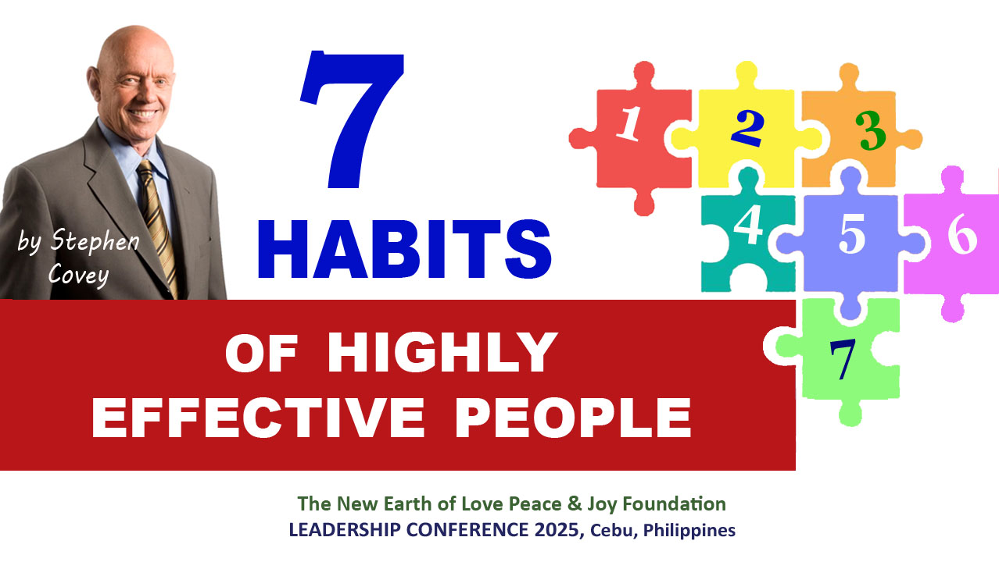

Slide 2
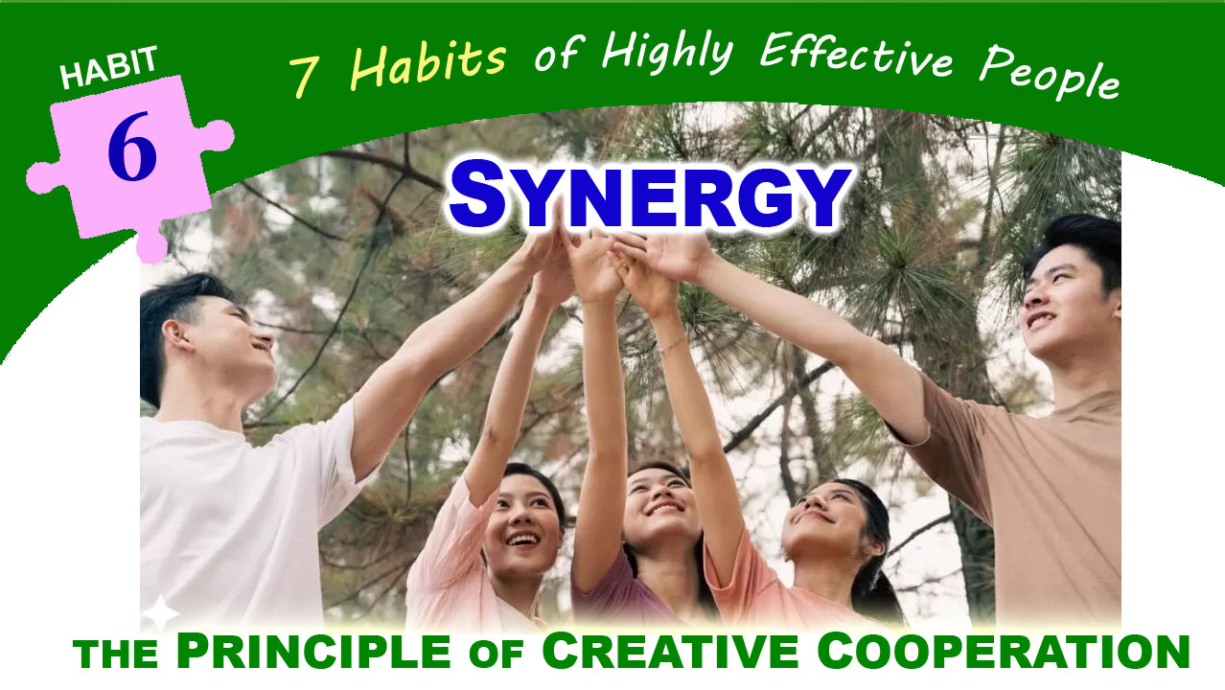

Slide 3

SYNERGIZE
The exercise of all of the other habits prepares us for the habit of synergy. It is the highest activity in all life- the true test and manifestation of all of the other habits put together.
SYNERGY IS THE ESSENCE OF PRINCIPLE-CENTERED LEADERSHIP.
It is the essence of principle-centered parenting.
It catalyzes, unifies, and unleashes the greatest powers within people. All the habits prepare us to create THE MIRACLE OF SYNERGY.

Slide 4
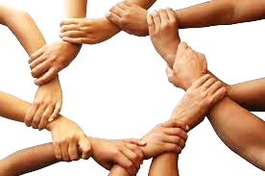
WHAT IS SYNERGY?
It means that the whole
is greater than the sum of its parts.
It means that the relationship which the parts have to each other is a part in and of itself.
It is not only a part, but the most catalytic, the most empowering, the most unifying, and the most exciting part.

Slide 5

SYNERGIZE - the process of combining or coordinating different elements—people, ideas, or resources—to produce a result that is greater than the sum of their individual effects.
Originated from the Greek words syn (together) and ergon (work), meaning "to work together.“
It emphasizes the power of creative cooperation. It involves valuing differences, building on strengths, and fostering an environment where collaboration leads to innovative solutions.

Slide 6
In summary, to synergize is to work together in a way that produces a combined effect greater than what could be achieved separately.
This happens when a team’s performance surpasses the combined efforts of its individual players, where the whole is greater than the sum of its parts.

Slide 7
Ex. Apple and Nike: The Power of Branding
The partnership between Apple and Nike is a prime example of how synergy can be harnessed to create a powerful brand image. By integrating Nike's fitness tracking technology with Apple's smartwatches and devices, the two companies were able to offer a seamless user experience for fitness enthusiasts. This collaboration not only strengthened their individual brand identities but also opened up new market opportunities. Through their combined efforts, Apple and Nike were able to tap into the growing demand for wearable technology and became leaders in the fitness tracking industry.
“Synergy is better than my way or your way. It’s our way.”

Slide 8
BENEFITS OF SYNERGY
Better problem-solving – when each member collaborate effectively, they can generate wider range of potential solutions, including those that might not have been considered individually.
Innovative solutions. It unlocks potential for innovation because it sparks creativity.
Stronger relationships – because this involves working together as a team towards achieving a common goal

Slide 9
BENEFITS OF SYNERGY
Higher team performance – when team members effectively collaborate and leverage each other’s skills, the overall productivity of the team will significantly increase.
Enhances personal growth – it allows individuals to leverage each other’s strengths, overcome challenges together, and learn from diverse perspectives, all of which contributes to personal development.

Slide 10
SYNERGY vs. COMPROMISE
Synergy and compromise are distinct approaches to collaboration
Compromise - mutually acceptable solution 1 +1 = 1.5
Synergy- superior outcome 1 + 1 = 5 or 10, 16 or even more
Compromise: everyone gives up something
Synergy: everyone gains something greater

Slide 11
Why synergy is more powerful?
Synergy, where the combined effort of a group is greater than the sum of individual efforts, is generally more powerful than compromise, which involves giving up parts of one’s goals to reach an agreement.
Synergy creates a win-win situation by finding solutions that are better than any individual solution, while compromise often results in a weakened outcome.

Slide 12

IMPORTANCE OF CREATIVE COOPERATION
For example, in a team setting, synergizing means that when individuals with diverse skills and perspectives collaborate, they can achieve outcomes that would be impossible individually.
This collaborative effort often
leads to enhanced creativity,
improved problem-solving,
and greater overall success
Examples from nature
(e.g., geese flying in V-formation)

Slide 13

KEY ELEMENTS of SYNERGY
1. Trust - where trust is absent or broken, synergy power deteriorates. As the saying goes, if you lose money, you lost nothing. If you lose a friend, you lost something but if you lose TRUST, you lost almost everything.
2. Valuing differences - the essence of synergy – the mental, the emotional, the psychological differences between people.

Slide 14
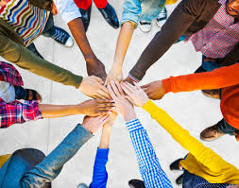
The key to valuing those differences
is to realize that all people see the world
not as it is, but as they are.
The person who is truly effective has the humility to recognize his own perceptual limitations and to appreciate the rich resources from interaction with others. That person values differences because those differences add to his knowledge and understanding. When we’re left to our own, there is shortage of data.

Slide 15

KEY ELEMENTS of SYNERGY
3. Open mindedness – by encouraging participation and welcoming ideas of others, the power of synergy builds up.
4. Mutual respect -Win-win mindset (links to Habit 4)
5. Diverse group problem-solving or brainstorming sessions

Slide 16
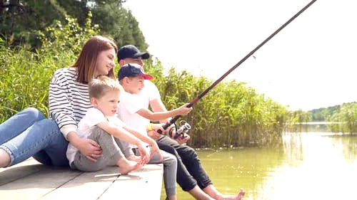
FISHING FOR
THE THIRD ALTERNATIVE
Envision the following scenario:
It’s vacation time, and a husband wants to take his family out to enjoy camping and fishing in a beautiful lake. This is important to him; he’s been planning it all year. He has made reservations already at a cottage on the lake and arranged to rent a boat, and his sons are really excited.
His wife, however, wants to use the vacation time to visit her ailing mother some 250 miles Away (about 8-hour drive). She doesn’t have the opportunity to see her very often, and this is important to her.

Slide 17
Their differences could be the cause of a major negative experience.
“The plans are set. The boys are excited. We should go on the fishing trip,” he says.
“But we don’t know how much longer my mother will be around, and I want to be with her. This is our only opportunity to have enough time to do that.,” she replies.
“All year long we’ve looked forward to this one-week vacation. The boys would be bored and miserable sitting around grandmother’s house for a week. Besides, she has your sister less than a mile away to take care of her,” he says.
“But she’s my mother, too. I want to be with her.”
“You could phone her every night. And we’re planning to spend time with her at the
Christmas family reunion. Remember?”

Slide 18
“That’s six months away. We don’t even know if she’ll still be here by then. Besides, she needs me, and she wants me.”
“She’s being well taken care of. Besides, the boys and I need you, too.”
“My mother is more important than fishing.”
“Your husband and sons are more important than your mother.”
As they disagree, back and forth, they finally may come up with some kind of compromise. They may decide to split up—he takes the boys fishing at the lake while she visits her mother. And they both feel guilty and unhappy. The boys sense it, and it affects their enjoyment of the vacation.

Slide 19
The husband may give in to his wife, but he does it grudgingly. And consciously or unconsciously, he produces evidence to fulfill his prophecy of how miserable the week will be for everyone.
The wife may give in to her husband, but if her mother were to become seriously ill and die, the husband could never forgive himself, and she couldn’t forgive him either.
Applying Win/Win (Habit 4), they believe in a third alternative, a solution that is mutually beneficial and is better.
In searching for the “middle” or higher way, this husband and wife realize that their love, their relationship, is part of their synergy.

Slide 20

As they communicate (Habit 5), the husband
really, deeply feels his wife’s desire, her need to
be with her mother. He understands that they
really don’t know how long she will be with them,
and that she certainly is more important than fishing.
And the wife deeply understands her husband’s desire to have the family together and to provide a great experience for the boys. She realizes the investment that has been made in lessons and equipment to prepare for this fishing vacation, and she feels the importance of creating good memories with them.

Slide 21
So they combined those desires. And they’re not on opposite sides of the problem. They’re together on one side, looking at the problem, understanding the needs, and working to create a third alternative that will meet them.
THIRD ALTERNATIVE
“Maybe we could arrange another time within the month for you to visit with your mother,” he suggests. “I could take over the home responsibilities for the weekend and arrange for some help at the first of the week so that you could go. I know it’s important to you to have that time.

Slide 22
“Or maybe we could locate a place to camp and fish that would be close to your mother. The area wouldn’t be as nice, but we could still be outdoors and meet other needs as well. And the boys wouldn’t be climbing the walls. We could even plan some recreational activities with the cousins, aunts, and uncles, which would be an added benefit.”
They synergize. They communicate back and forth until they come up with a solution they both feel good about. It’s better than the solutions either of them originally proposed. It’s better than compromise. They get what they both really want and build their relationship in the process.

Slide 23


Slide 24

BARRIERS to Synergy
Ego – a person’s self-esteem or
self-importance. Individual
motivations can sometimes lead to selfishness and a competitive spirit, which can be detrimental to teamwork and synergy.
2. Prejudice – this can lead to discrimination, lack of trust, making it difficult for diverse individuals or groups to work together effectively. It can create a climate of hostility and division, undermining the potential for synergy.

Slide 25

3. Miscommunication –
when messages are not clear,
team members struggle to coordinate
their efforts, leading to a lack of shared understanding and a decline in overall performance. Team members may not understand their roles or responsibilities, leading to delays and mistakes.
4. Fear of change – this fear, often rooted in uncertainty and the unknown, can lead individuals to resist new ideas, processes or collaboration opportunities

Slide 26

HOW TO PRACTICE SYNERGIZING
(Strategies to Cultivate Synergy)
Call to Action. Practice SYNERGY DAILY!
1. Listen empathetically (Habit # 5)
2. Celebrate differences –
by being interested and open to the
differences between us we can discover
new ideas and ways of thinking as well
as making new friends and experiencing
different opportunities.

Slide 27
HOW TO PRACTICE SYNERGIZING
(Strategies to Cultivate Synergy)
Call to Action. Practice SYNERGY DAILY!
3. Seek third alternatives – higher-level solution that benefits all parties involved.
4. Build trust within the team - this requires consistent effort and a focus on fostering positive relationships. This can be done by demonstrating transparency, providing regular feedback and encouraging open communication, acknowledging mistakes and advocating for team members.

Slide 28
“Alone we can do so little;
together we can do so much.” ~ Helen Keller
Alone, we cannot make the New Earth happen.
Together we can say in Jesus’ name that we can make our New Earth Vision a reality.
Can we stand together and with Faith and strong conviction, shout to the whole world our vision that will soon be a REALITY:

Slide 29

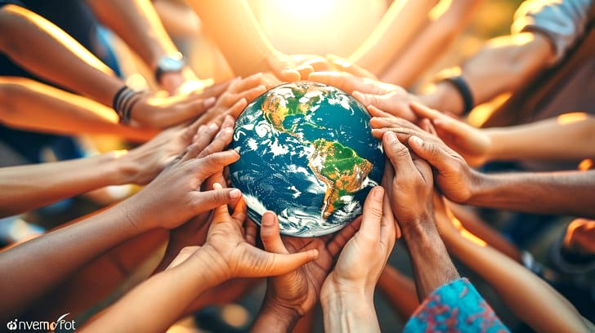


THE NEW EARTH OF LOVE, PEACE & JOY
where JESUS IS KING BECAUSE MAMA MARY
is GREATLY LOVED BEGINNING FROM THE PHILIPPINES!

Slide 30


